Slide 1
CHAPTER 3: PROFESSIONAL ETHICS
TS. DR. ROZI NOR HAIZAN BINTI NOR

Slide 2
Objectives
Describe the relationship to be managed by IT professional
State the professional code of ethics for software engineers
Know the related law for IT
Making an ethical decision

Slide 3
Contents
IT professional
IT professional relationship to be managed
Professional Code of Ethics
Related laws in regards of IT/ICT
Making ethical decision

Slide 4
IT Profession
Profession (Webster) : A calling requiring specialized knowledge and often long and intensive academic preparation
Profession (informal)
High level of education
Practical experience
Decisions have impact

Slide 5

IT Profession
Professional: someone who requires advanced training and experience, must exercise discretion and judgment in the course of his or her work
Who recognizes his or her obligation to society by living up to established and accepted codes of conduct

Slide 6

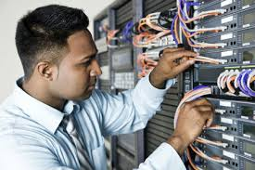
IT Professional
Many workers in IT industry are considered to be professional:
programmers/analysts
Software engineers
Database administrators
LAN administrators
CIOs
etc

Slide 7

Professional relationships to be managed
An ethical IT professional acts honestly and appropriately, and
at all time steer away from any unethical action
Relationships
IT professional-employer
IT professional-client
IT professional-supplier
IT professional-professional
IT professional-IT user
IT professional-society

Slide 8
IT Professional-Employer
Term of employment
job title, performance expectation, work responsibility, drug testing, location of employment, salary, dress code, etc.
Policies, procedures manual, or code of conduct
protection of secrets, vacations, use of company resources, etc
Some specific aspect – programming language to be used, etc

Slide 9
IT Professional-Employer
Must set example and enforce the policies in regards to ethical use of IT
Have knowledge and skill to abuse systems and data or to allow others to do so
Some ethical issues
- software piracy
- trade secret
- whistle-blowing

Slide 10
IT Professional-Client
Whom professional provides services
Can be from outside or internal
Some ethical issues
- actual status of projects
- trusted recommendation

Slide 11
IT Professional-Supplier
Dealing with hardware, software, and service providers
Some ethical issues
- fair in dealing with suppliers and do not make unreasonable demands
- accept bribe

Slide 12
IT Professional-Professional
Loyalty to other members of profession
Some ethical issues
- resume inflation
- inappropriate sharing of corporate information

Slide 13
IT Professional-IT User
Employs the product to deliver organization benefits or to increase productivity
A duty to understand to needs and capabilities of users
To deliver product and services that best meet these needs within budget and time constraint
Discourage piracy, minimize the appropriate use of computing resources, avoid the inappropriate sharing of information
Establishment of IT usage policy

Slide 14

IT Professional-Society
Practice in ways that not only causes no harm but also provide significant benefits
To establish and maintain professional standards that protect public

Slide 15
CLASS DEBATE
How do you distinguish between misrepresentation and embellishment of one’s professional accomplishments in order to win a contract to complete a major project? Provide an example of an embellishment that would not be considered misrepresentation.

Slide 16
Professional Codes of Ethics
States the principles and core values essential to the work of a particular occupational group.
Laws do not provide a complete guide to ethical behaviour – illegality does not mean ethical
Help to ensure:
- abiding the laws
- following necessary regulations
- behaving in an ethical manner

Slide 17
Professional Codes of Ethics - Benefits
Improves ethical decision making
- use common set of core values and beliefs to serve as a guideline
Promote high standard of practice and ethical behavior
- reminder of responsibilities and duties
- defines acceptable and unacceptable behavior
Enhances trust and respect from the public
- depends on the integrity and good judgment to tell the truth, abstain from giving self-serving advice, and offer warning of potential negative side effects.
Provides an evaluation benchmark
- self assessment and peer evaluation

Slide 18
Types of Code of Ethics
Association for Computing Machinery (ACM) Code of Ethics and Professional Conduct
Association of Information Technology Professional (AITP) Code of Ethics
Computer Society of the Institute of Electrical and Electronics Engineers (IEEE-CS) – Software Engineering Code of Ethics and Professional Practices (SECEPP)

Slide 19
Software Engineering Codes of Ethics and Profesional Practice (SECEPP)
Preamble
Principles
download at:
http://www.ics.uci.edu/~redmiles/ics131-FQ03/week08ethics/IEEE-ACM-Ethics.PDF

Slide 20
Preamble
Software engineers have opportunities to do good or cause harm, or to influence others to do good or cause harm
Software engineers ought to be committed to doing good
Eight principles identify key ethical relationships and obligations within these relationship
Code should be seen as a whole, not a collection of parts
Concern for the public interest is paramount

Slide 21
Principles
Principle 1 Public
software engineers shall act consistently with the public interest
Principle 2 Client and Employer
software engineers shall act in a manner that is in the best interests of their client and employer and that is consistent with the public interest

Slide 22
Principles
Principle 3 Product
software engineers shall ensure that their products and related modifications meet the highest professional standards possible
Principle 4 Judgment
software engineers shall maintain integrity and independence in their professional judgment

Slide 23
Principles
Principle 5 Management
software engineering managers and leaders shall subscribe to and promote an ethical approach to the management of software development and maintenance
Principle 6 Profession
software engineers shall advance the integrity and reputation of the profession consistent with the public interest

Slide 24
Principles
Principle 7 Colleagues
software engineers shall be fair to and supportive of their colleagues
Principle 8 Self
software engineers shall participate in lifelong learning regarding the practice of their profession and promote an ethical approach to the practice of the profession

Slide 25
Alternative List (virtues discipline-independent)
Be impartial : 1.02, 1.03, 1.05, 1.07, 3.03, 3.12, 4.01, 6.05
Disclose information that others ought to know : 1.04, 1.06, 2.06, 2.07, 3.01, 4.05, 4.06, 5.05, 5.06, 6.07, 6.08, 6.09, 6.12, 6.13
Respect the rights of others : 2.02, 2.03, 2.05, 3.13
Treat others justly : 5.06, 5.07, 5.08, 5.09, 5.10, 5.11, 5.12, 7.03, 7.04, 7.05, 7.07, 8.07

Slide 26
Alternative List (virtues discipline-independent)
Take responsibility for your actions and inaction : 1.01, 3.04, 3.05, 3.06, 3.07, 3.08, 3.10, 3.11, 3.14, 3.15, 4.02, 7.08
Take responsibility for the actions of those you supervise : 5.01, 5.02, 5.03, 5.04
Maintain your integrity : 2.01, 2.04, 2.08, 2.09, 3.01, 3.02, 3.09, 4.03, 4.04, 6.06, 6.10, 6.11, 8.08, 8.09
Continually improve your ability : 8.01-8.06
Share your knowledge, expertise, and values: 1.08, 6.01-6.04, 7.01,7.02, 7.06

Slide 27
Case Study – evaluate moral problem using SECEPP
A three step process
1) consult and identify relevant fundamental principle (alternative list)
2) search the list of clauses to see the most directly speak for the relevant principles
3) determine whether the contemplated action aligns with or contradicts the statement in the clauses. If the action agrees with all of the clauses --> strong evidence the action is moral. If is in disagreement with all the clauses --> safe to say the action is immoral

Slide 28
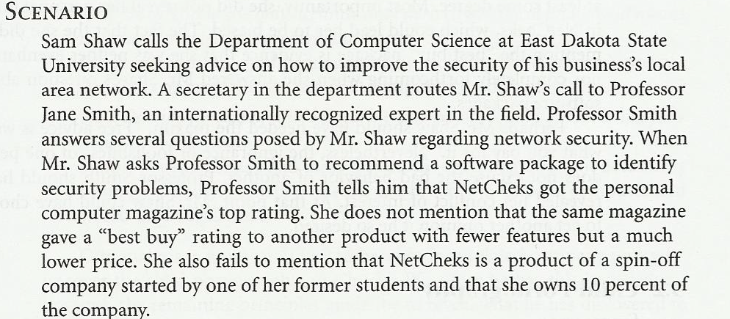
Case 1– Software Recommendation

Slide 29
Case 1– Software Recommendation
Sam Shaw asks for free advise on LAN security
Prof. Smith answers questions and recommends top-ranked package
Prof Smith does not disclose
- she has financial interest in company producing top-ranked package
- another package was given a “best-buy” rating
Did Prof. Smith do anything wrong?

Slide 30
Analysis – Software Recommendation
Most relevant principles/disciplines
be impartial
disclose information others ought to know
share your knowledge, expertise, and values
Clause 1.06: Prof Smith was deceptive
Clauses 1.08, 6.02: prof smith freely gave valuable information
Clauses 4.05,6.05 : prof smith did not reveal conflict of interest
Conclusion: Professor Smith should have revealed her conflict of interest to Mr. Shaw.

Slide 31
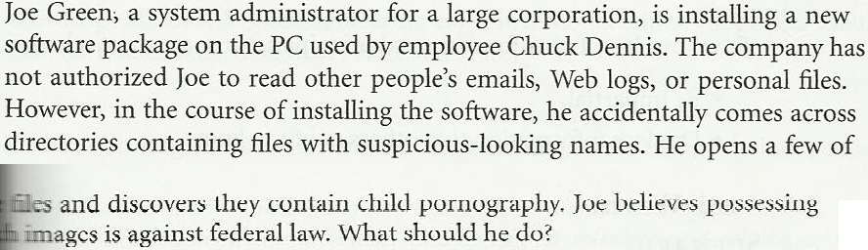
Case 2: Child Pornography

Slide 32
Case 2: Child Pornography
Joe Green a system administrator
Asked to install new software package on Chuck Dennis’s computer
Green not authorized to read other people’s emails or personal files
Green sees suspicious-looking file names
He opens some of Dennis’s files and discovers child pornography
What should he do?

Slide 33
Analysis (1/2)
Most relevant principles/disciplines
Be impartial
Respect the rights of others
Treat others justly
Maintain your integrity

Slide 34
Analysis (2/2)
Most relevant clauses
2.03: Somebody has misused the company PC
2.09: Someone is using the PC for a purpose not in the employer’s interest
3.13: Joe violated the policy against opening files
5.10: Someone else may have planted the files on Chuck’s computer

Slide 35
Conclusions
Conclusions:
Joe was wrong to violate company policy to uncover child pornography
Once he has this knowledge, however, he is obliged to share it with company authorities
Joe should be discreet

Slide 36
Case 3: Anti-Worm
Internet plagued by new worm that exploits hole in popular operating system
Tim Smart creates anti-worm that exploits same security hole
Tim’s anti-worm fixes PCs it infects. It also uses these PCs as launch pad to reach new PCs.
Tim launches anti-worm, taking pains to keep it from being traced back to him.
The anti-worm quickly spreads through Internet, infecting millions of computers
System administrators around the world combat the anti-worm

Slide 37
Analysis (1/2)
Most relevant principles
Continually improve your abilities.
Share your knowledge, expertise, and values.
Respect the rights of others.
Take responsibility for your actions and inactions.

Slide 38
Analysis (2/2)
Most relevant clauses:
1.01: Tim did not accept responsibility for his action.
1.08: The worm was free, but cost system administrators a lot of time.
2.03: The anti-worm entered computers without permission of their owners.
8.01, 8.02, 8.06: Tim improved his knowledge and skills by creating the anti-worm.

Slide 39
Conclusions
Conclusions:
Tim’s welfare is less important than the public good
By attempting to hide his identity, Tim refused to accept responsibility for his actions
Tim violated the property rights of the PC owners whose systems were infected by his anti-worm
Tim violated the Code

Slide 40
Case 4: Consulting Opportunity
Jean works in support organization for Acme Corporation
Many Acme customers downgrading their level of support
East Dakota gives Jean opportunity to run a training class similar to that provided by Acme
Jean tells no one at Acme
Jean develops materials at home on own time
Jean takes paid vacation to teach class

Slide 41
Analysis (1/2)
Most relevant principles
Be impartial.
Take responsibility for your actions and inactions.
Disclose information that others ought to know.
Maintain your integrity.
Continually improve your abilities.

Slide 42
Analysis (2/2)
Most relevant clauses:
3.04: Jean was well qualified to develop materials and teach class
8.04: By creating materials, Jean became even more familiar with Acme’s package and its capabilities
4.05: Jean didn’t disclose his conflict of interest with his employer
2.08: Jean deprived himself of “time off” needed to do his best work at Acme
6.05: Jean put his own interest above that of his employer

Slide 43
Conclusions
Conclusions:
Jean did not disclose East Dakota’s offer or his decision to Acme’s management
Acme’s management is likely to question Jean’s loyalty to the company
Jean’s actions were wrong and unwise

Slide 44
ACM Code of Ethics
Consisting of 24 imperatives formulated as statements of personal responsibility, identifies the elements of such a commitment
General Moral Imperatives
Specific Professional Responsibility
Organizational Leadership Imperatives
Compliance with the Code

Slide 45
General Moral Imperatives
As an ACM member I will:
1.1 Contribute to society and human well-being
1.2 Avoid harm to others
1.3 Be honest and trustworthy
1.4 Be fair, and take action not to discriminate
1.5 Honor property rights including copyrights and patents
1.6 Give proper credit for intellectual property
1.7 Respect privacy of others
1.8 Honor confidentiality

Slide 46
Specific Professional Responsibilities
As an ACM computing professional I will:
2.1 Strive to achieve the highest quality in both the process and products of professional work
2.2 Acquire and maintain professional competence
2.3 Know and respect existing laws pertaining to professional work
2.4 Accept and provide appropriate professional review
2.5 Give comprehensive and thorough evaluation of computer system and their impacts, including analysis of possible risk

Slide 47
Specific Professional Responsibilities
As an ACM computing professional I will:
2.6 Honor contracts, agreements, and assigned responsibilities
2.7 Improve public understanding of computing and its consequences
2.8 Access computing and communication resources only when authorized to do so

Slide 48
Organizational Leadership Imperatives
As an ACM member and an organizational leader, I will:
3.1Articulate social responsibilities of members of an organizational unit and encourage full acceptance of those responsibilities
3.2 Manage personnel and resources to design and build information systems that enhance the quality, effectiveness and dignity of working life
3.3 Acknowledge and support proper and authorized uses of an organization’s computing and communications resources

Slide 49
Organizational Leadership Imperatives
As an ACM member and an organizational leader, I will:
3.4 Ensure that users and those who will be affected by a computing system have their needs clearly articulated during the assessment and design of requirement. Later the system must be validated to meet requirements
3.5 Articulate and support policies that protect the dignity of users and others affected by a computing system
3.6 Create opportunities for members of the organization to learn the principles and limitations of computer systems

Slide 50
Compliance with code
4.1 Uphold and promote the principles of this code
4.2 Treat violations of this code as inconsistent with membership in the ACM

Slide 51
Some emphasizes of the codes
Honesty and fairness
SE 1.6, 2.1, 6.7, Professional behaviour, 7.4, 7.5
ACM 1.3, 1.4
responsibilities to respect confidentiality
SE 2.5, ACM 1.8
Maintain professional competence
SE 8.1 – 8.5, AM 2.2
Aware of relevant laws
SE 8.5, ACM 2.3
Honor contracts and agreement
ACM 2.6

Slide 52
Some emphasizes of the codes
Respect and protect privacy
SE 1.3, 3.12, ACM 1.7
Avoid harm to others
SE 1.3, ACM 1.2
Respect property right
SE 2.2, 2.3, ACM 1.5, 1.6, 2.8

Slide 53
IT Users
Software piracy.
Inappropriate use of computing resources.
Inappropriate sharing of information.

Slide 54
Supporting Ethical Practices of IT Users
Define and limit the appropriate use of IT resources.
Establish guidelines for the use of company software.
Structure information systems to protect data and information.
Install and maintain a corporate firewall

Slide 55
Summary
A professional is someone:
who requires advanced training and experience.
who exercises discretion and judgment during work.
whose work cannot be standardized.
IT professionals have many different relationships that have different ethical issues.

Slide 56
Summary
A professional code of ethics states the principles and core values essential to the work of a particular occupational group.
Licensing and certification of IT professionals would increase the reliability and effectiveness of information systems.

Slide 57
Summary
IT users encounter many ethical issues, including:
Software piracy.
Inappropriate use of IT resources.
Inappropriate sharing of private and secret data.
An IT usage policy helps users understand how to appropriately use IT resources.

